Slide 1
Global Goals Hackathon
Problem Statement : The Silent Organizer
Subtitle : A Tool for Effortless Organization &
Smarter Digital Habits
Team : HackStarters
Presented by : K .Venkat
A.Srivalli
K.Josh Kumar
J.Gayathri

Slide 2
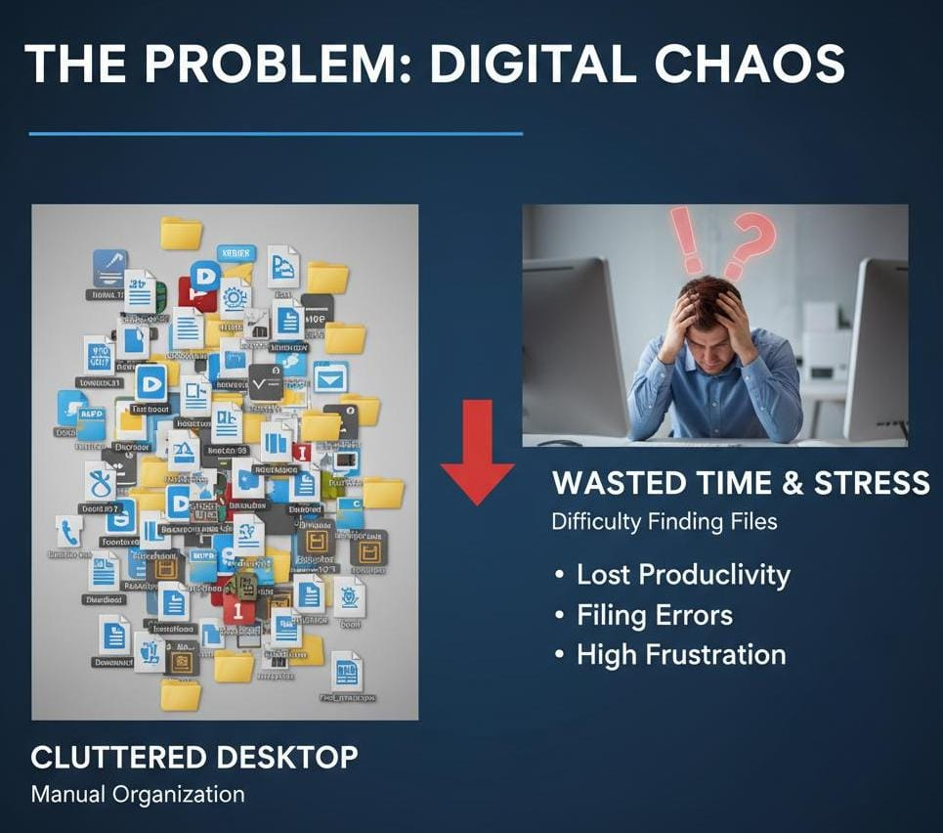
The Problem: Digital Chaos & Lost Focus
stress caused by manual file management.This slide sets the stage by visuallyhighlighting the clutter
Visually compares the old, inefficient way of doing things with the new, streamlined solution

Slide 3
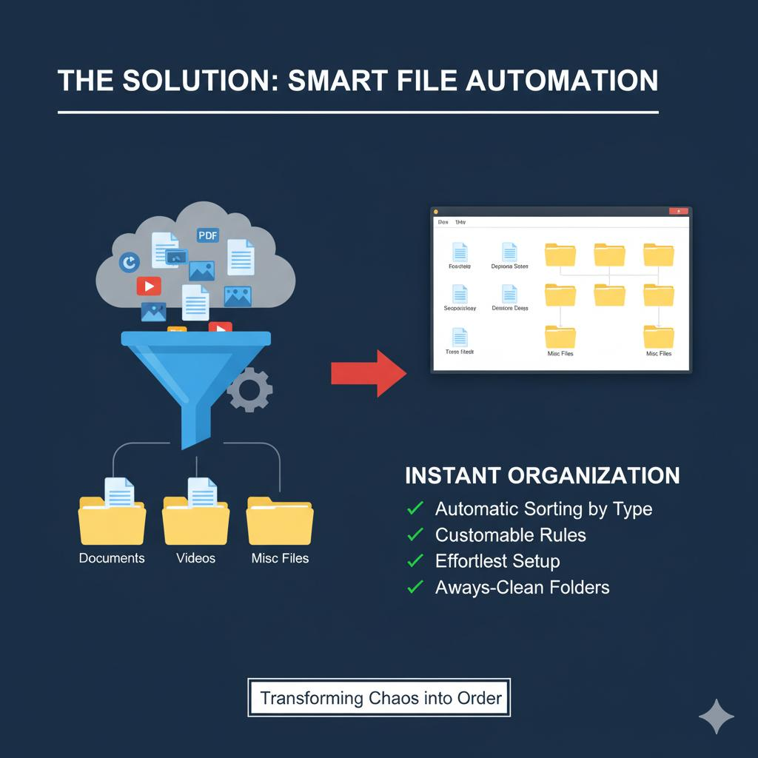
Project Overview & The Solution
This slide introduces the proposed solution, visually representing the system that sorts files efficiently and automatically.
How It Works:
  Monitors: Actively watches the Downloads folder.(Watchdogs)
  Identifies: Instantly recognizes file types (Pictures, Documents, Videos, etc.).
  Organizes: Automatically moves each file to its designated home.

Slide 4
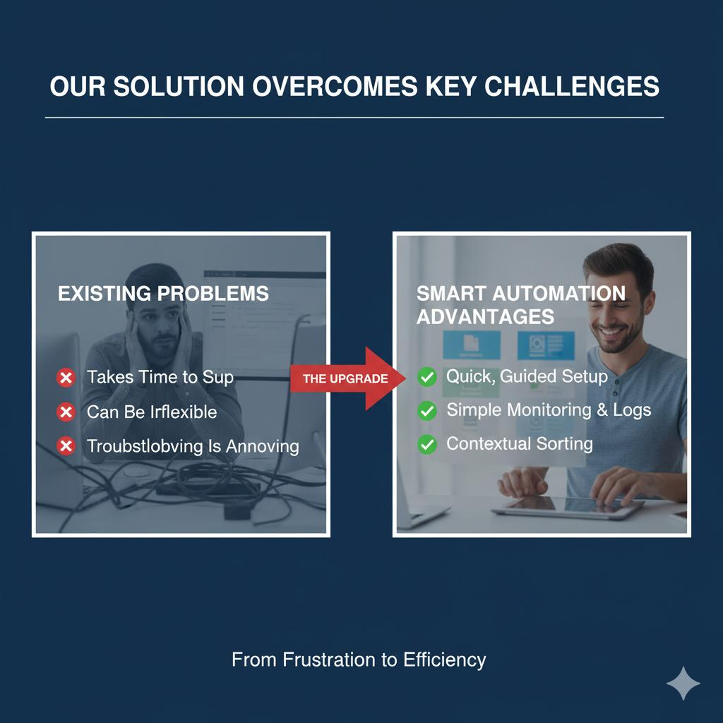
Workflow
The Automated Workflow:
  A file is downloaded to the Downloads folder.
  The Silent Organizer's background process detects the new file.
  It reads the user-defined rules from a simple config.json file.
  The file is instantly moved to the correct destination folder (e.g., Pictures or Documents).
  The action is logged for the user's reference.

Slide 5

LIVE DEMONSTRATION
This slide uses the SDG 4 icon to visually represent the connection and lists the educational benefits of the automated system.

Slide 6

Impact, SDGs & Future Vision
Primary Impact: SDG 4 (Quality Education):
  Promotes digital literacy by teaching the fundamental skill of file management.
Additional SDG Alignments:
  SDG 12 (Responsible Production): Fights digital clutter and promotes efficient resource management.
  SDG 9 (Innovation & Infrastructure): A practical innovation that improves personal digital workflow.

Slide 7
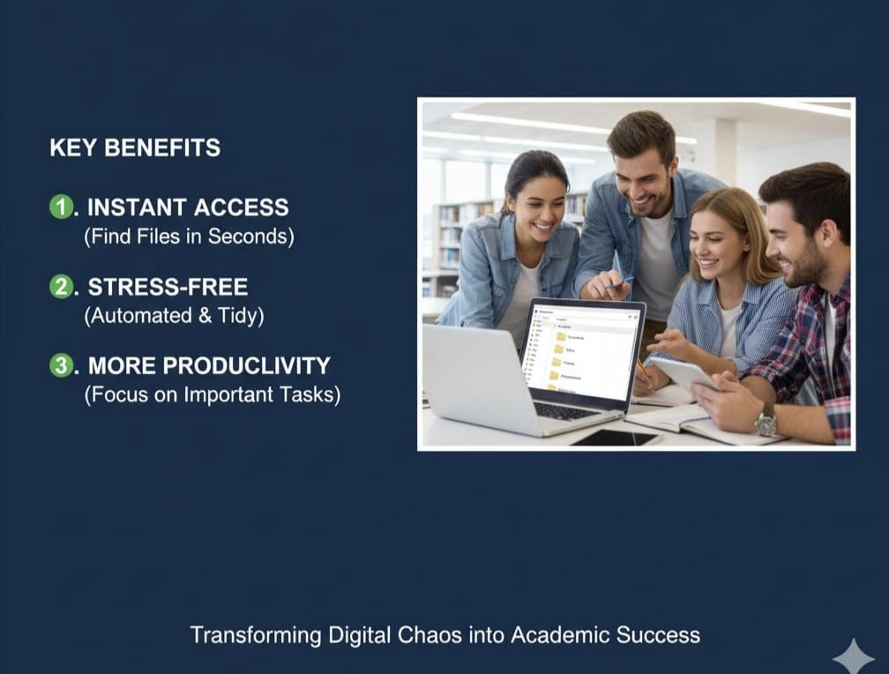
Usages & Benefits
Our automated system saves valuable time and eliminates the stress of file management. It empowers students and teachers to focus on their work, not on organizing digital clutter.

